Slide 1

WDT ~ Practical
Eng. Muhammad Saeed
Eng. Mohammed Abusarie
sinaiuniversity.net

Slide 2
Goals
Learn ASP.NET Core MVC
For building web apps using the Model-View-Controller design pattern.
@Sinaiunieg
info@su.edu.eg
www.su.edu.eg

Slide 3
Outline
C#
Basics
OOP
Advanced Topics
LINQ
Entity Framework
ASP.NET Core MVC
@Sinaiunieg
info@su.edu.eg
www.su.edu.eg

Slide 4
C# Basics
@Sinaiunieg
info@su.edu.eg
www.su.edu.eg

Slide 5
Introduction
.NET Core :
.NET core is a free, open-source development platform maintained by Microsoft. It is a cross-platform framework that runs on Windows, macOS, and Linux operating systems.
.NET Core Framework can be used to build different types of applications such as mobile, desktop, web, cloud, IoT, machine learning, game, etc.
@Sinaiunieg
info@su.edu.eg
www.su.edu.eg

Slide 6
Introduction
C# (C Sharp) is an object-oriented programming language created by Microsoft.
C# is a general-purpose programming language.
Computer games, desktop applications, web applications, etc.
C# identifiers are case-sensitive.
@Sinaiunieg
info@su.edu.eg
www.su.edu.eg

Slide 7
Introduction
General-purpose programming language VS Application specific programming language:
A general-purpose programming language provides a comprehensive set of features and tools that allow developers to write code for various applications and tasks. Examples of general-purpose programming languages include Python, Java, C++, and JavaScript.
An application-specific programming language is designed to address the specific needs and requirements of a particular application domain or problem space. Examples of application-specific programming languages include SQL for database management and MATLAB for numerical computing.
@Sinaiunieg
info@su.edu.eg
www.su.edu.eg

Slide 8
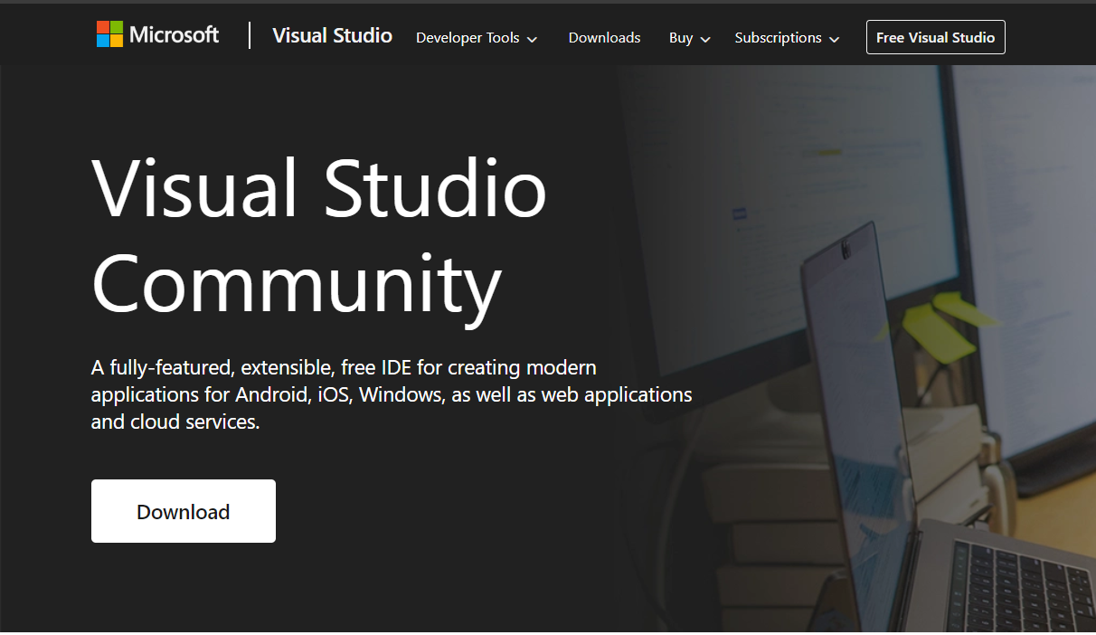
Integrated Development Environment (IDE)
The most popular choice is Microsoft’s own Visual Studio (Visual Studio Community).
@Sinaiunieg
info@su.edu.eg
www.su.edu.eg

Slide 9
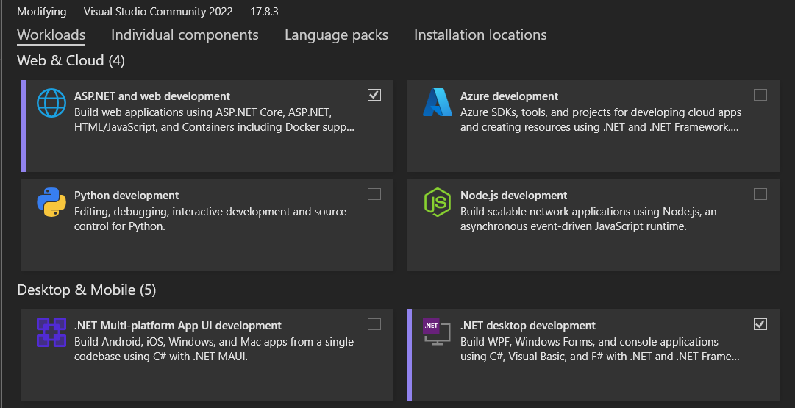
Integrated Development Environment (IDE)
@Sinaiunieg
info@su.edu.eg
www.su.edu.eg

Slide 10
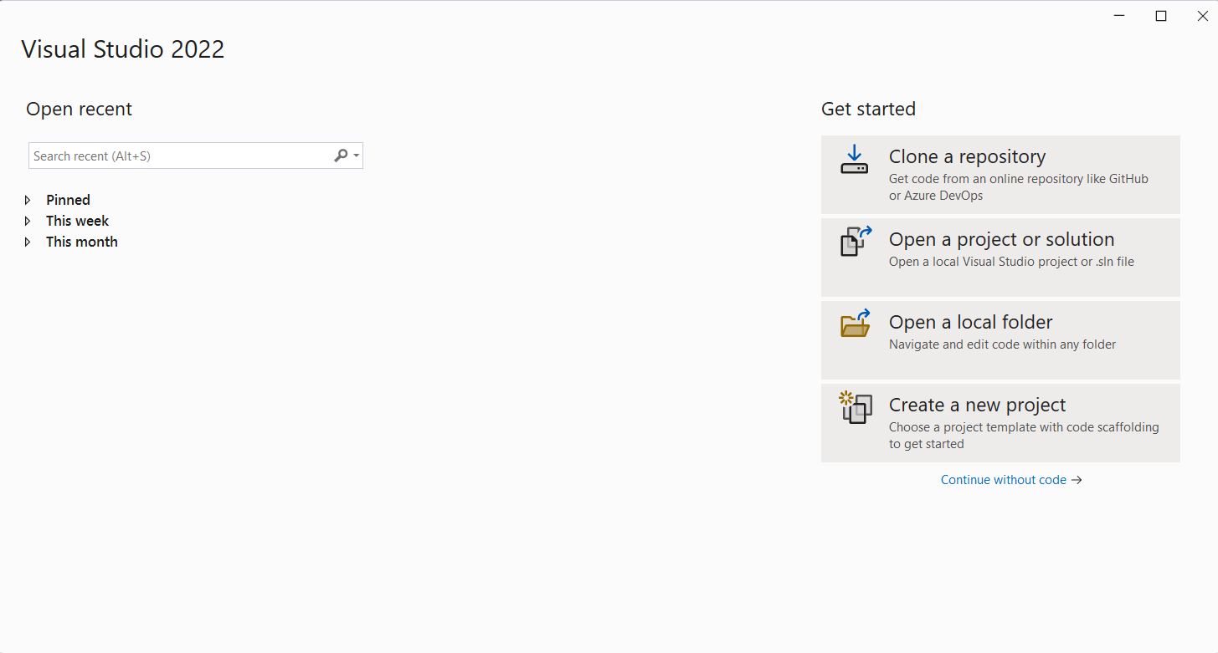
Creating a Project
@Sinaiunieg
info@su.edu.eg
www.su.edu.eg

Slide 11
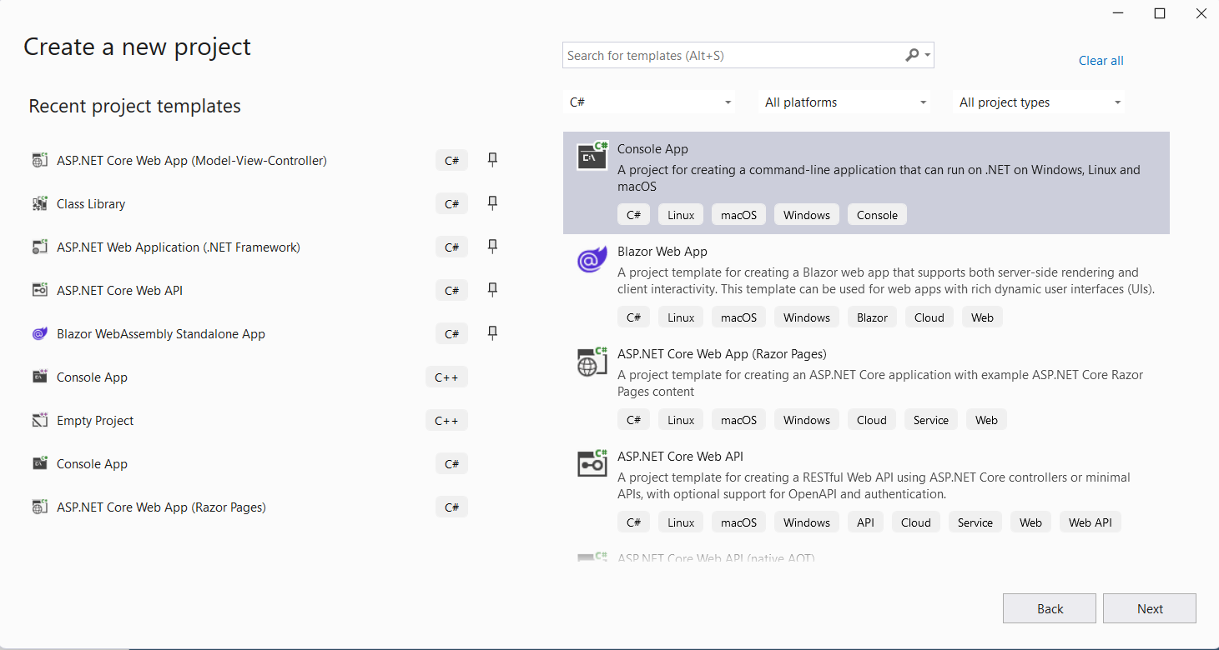
Creating a Project
@Sinaiunieg
info@su.edu.eg
www.su.edu.eg

Slide 12
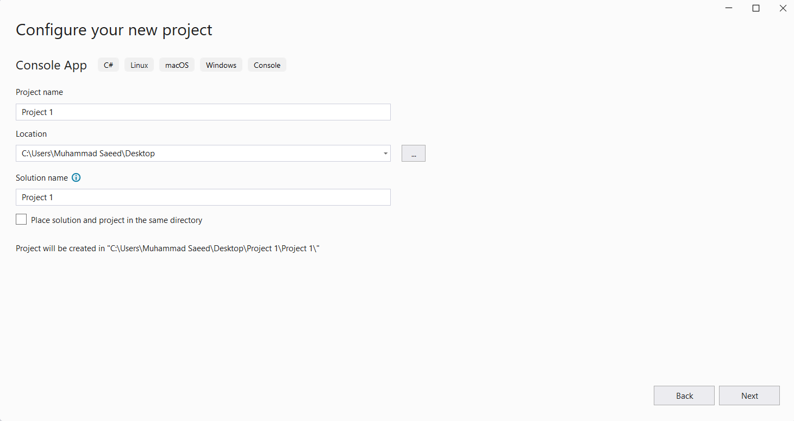
Creating a Project
@Sinaiunieg
info@su.edu.eg
www.su.edu.eg

Slide 13
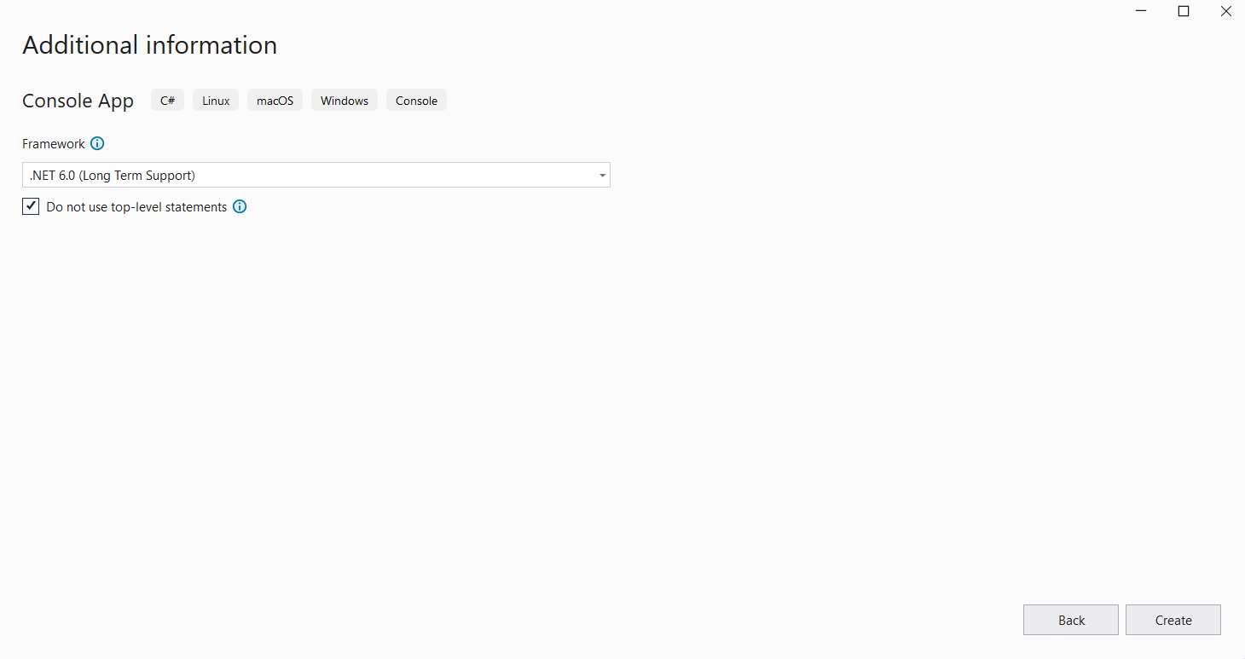
Creating a Project
@Sinaiunieg
info@su.edu.eg
www.su.edu.eg

Slide 14
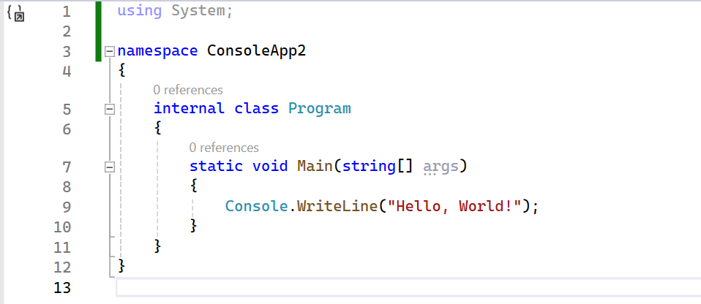
Creating a Project
@Sinaiunieg
info@su.edu.eg
www.su.edu.eg

Slide 15
First Program - Hello World
Basic program structure:
using System:
The ‘using’ statement is used to import existing .Net modules/namespaces in our application.
namespace ConsoleApp2:
A namespace is a container which holds related code together, helping us organize the program.
A namespace is just a logical grouping of classes.
@Sinaiunieg
info@su.edu.eg
www.su.edu.eg

Slide 16
First Program - Hello World
Basic program structure:
class Program:
All code needs to be defined in a self-sustaining module called a ‘Class.’ Every class belongs to a namespace.
Main():
The Main function is a special function which is automatically called when a console application runs.
@Sinaiunieg
info@su.edu.eg
www.su.edu.eg
Notes:
The global namespace is the namespace that contains namespaces and types that aren't declared inside a named namespace.

Slide 17
First Program - Hello World
Basic program structure:
WriteLine:
Here we are using an inbuilt method called ‘WriteLine’ to write the string “Hello World” in the console.
@Sinaiunieg
info@su.edu.eg
www.su.edu.eg

Slide 18
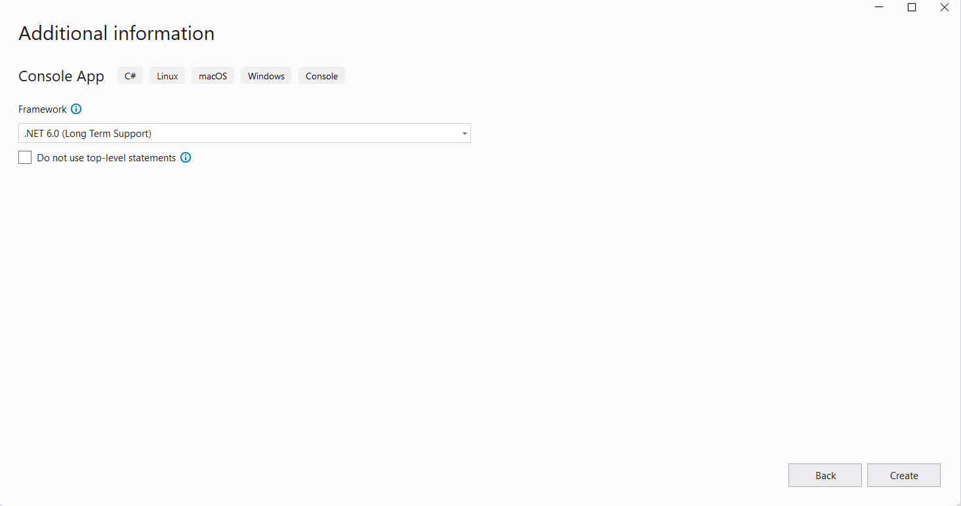
Creating a Project
@Sinaiunieg
info@su.edu.eg
www.su.edu.eg

Slide 19
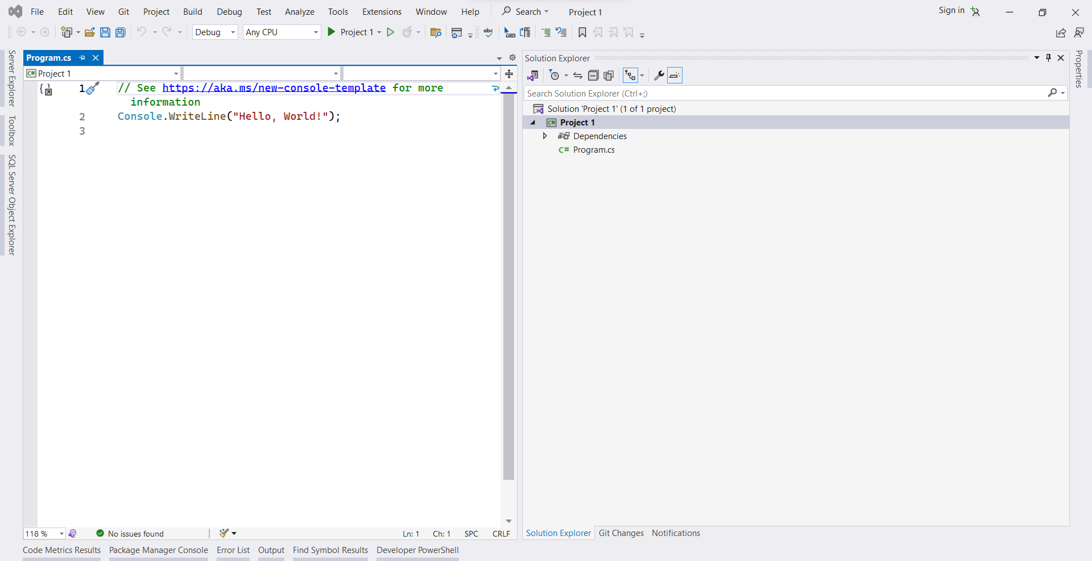
Creating a Project
@Sinaiunieg
info@su.edu.eg
www.su.edu.eg

Slide 20
Top-level statements:
The term top-level statements means the compiler generates the class and method elements for your main program.
Global using directives:
A global using directive imports a namespace for your whole application instead of a single file.
@Sinaiunieg
info@su.edu.eg
www.su.edu.eg

Slide 21
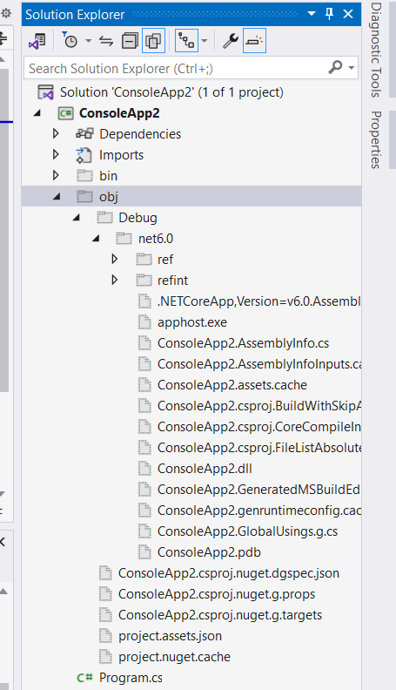
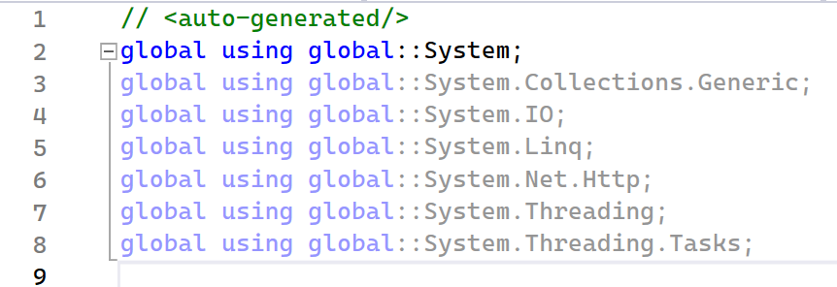
Global using directives:
@Sinaiunieg
info@su.edu.eg
www.su.edu.eg

Slide 22
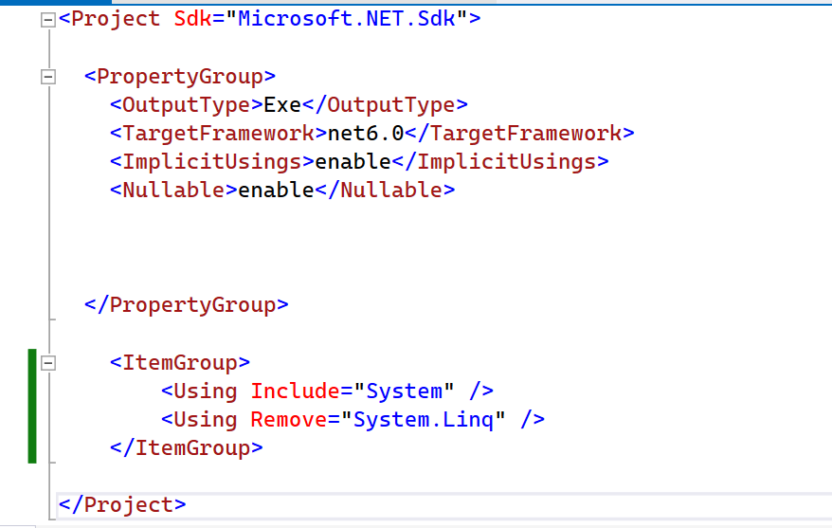
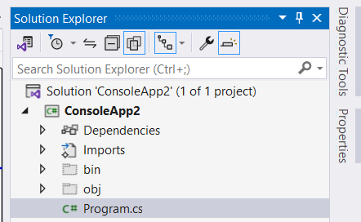
Global using directives:
@Sinaiunieg
info@su.edu.eg
www.su.edu.eg

Slide 23

Statements:
A simple statement is terminated by a semicolon (;).
Identifiers:
Names of variables, functions, classes, methods, and so on.
The identifier names follow these rules:
The alphabetic (a through z, A through Z)
Underscore (_) characters can appear at any position.
Digits cannot appear in the first position but everywhere else.
@Sinaiunieg
info@su.edu.eg
www.su.edu.eg
Notes:
Simple statements are used for performing a single task or operation.
Compound statements are used for executing multiple tasks or operations in specific contexts such as loops, conditional statements, and functions.

Slide 24
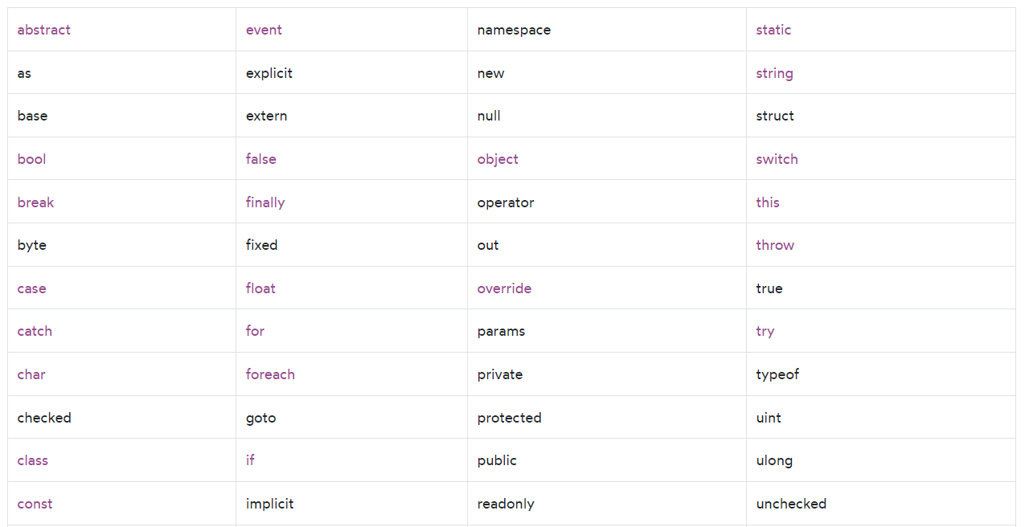
Keywords:
Keywords are names that have special meanings to the compiler.
All keywords are reserved identifiers. Therefore, you cannot use them as identifiers.
@Sinaiunieg
info@su.edu.eg
www.su.edu.eg

Slide 25
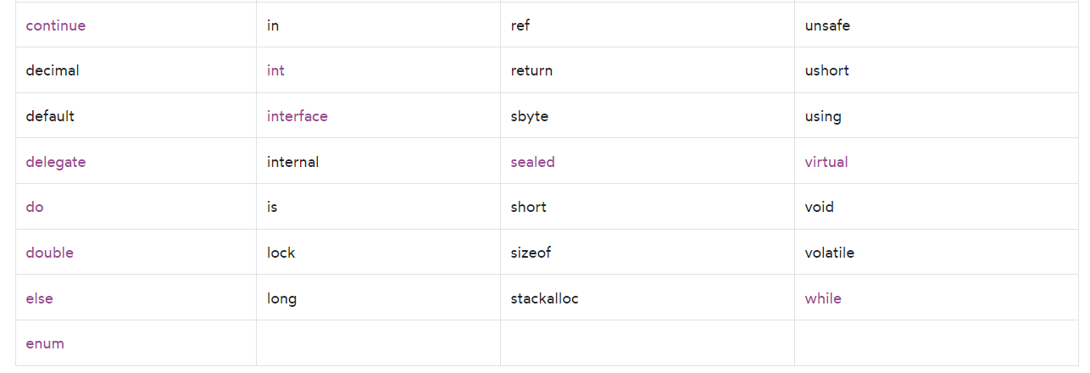
Keywords:
@Sinaiunieg
info@su.edu.eg
www.su.edu.eg

Slide 26
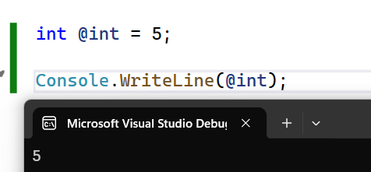
If you must use an identifier with the same name as a reserved keyword, you can prefix it with the @ symbol. For example:
@Sinaiunieg
info@su.edu.eg
www.su.edu.eg

Slide 27
Comments:
You use comments to explain the code or document it. The C# compiler ignores comments when compiling the program.
C# support three types of comments:
Single-line comments
Multi-Line comments
Documentation comments
@Sinaiunieg
info@su.edu.eg
www.su.edu.eg

Slide 28
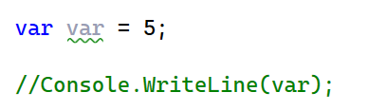
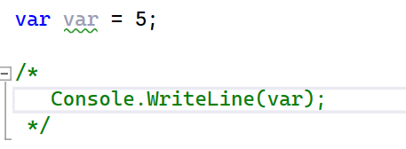
Single-line comments
A single-line comment begins with a double forward-slash (//) and continues to the end of the line.
Multi-Line comments
A delimited comment starts with /* and ends with */.
@Sinaiunieg
info@su.edu.eg
www.su.edu.eg

Slide 29

C# Variables:
Declare variables:
type variableName;
By convention, variable names are in the camel case and start with a letter. For example color, textColor, and backgroundColor.
@Sinaiunieg
info@su.edu.eg
www.su.edu.eg

Slide 30
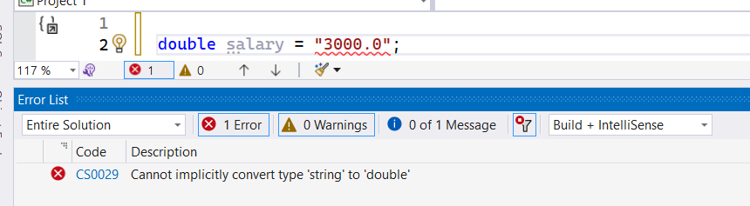

C# Variables:
C# is a type-safe language. It means that the compiler will ensure that the variable will always store a value of the declared type.
@Sinaiunieg
info@su.edu.eg
www.su.edu.eg

Slide 31
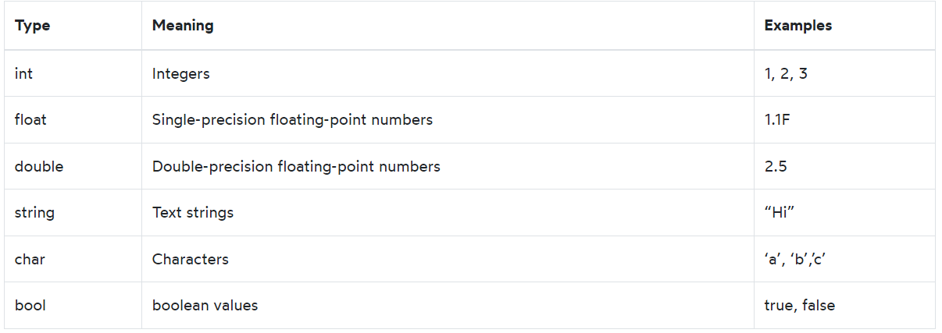
C# Data Types:
@Sinaiunieg
info@su.edu.eg
www.su.edu.eg

Slide 32
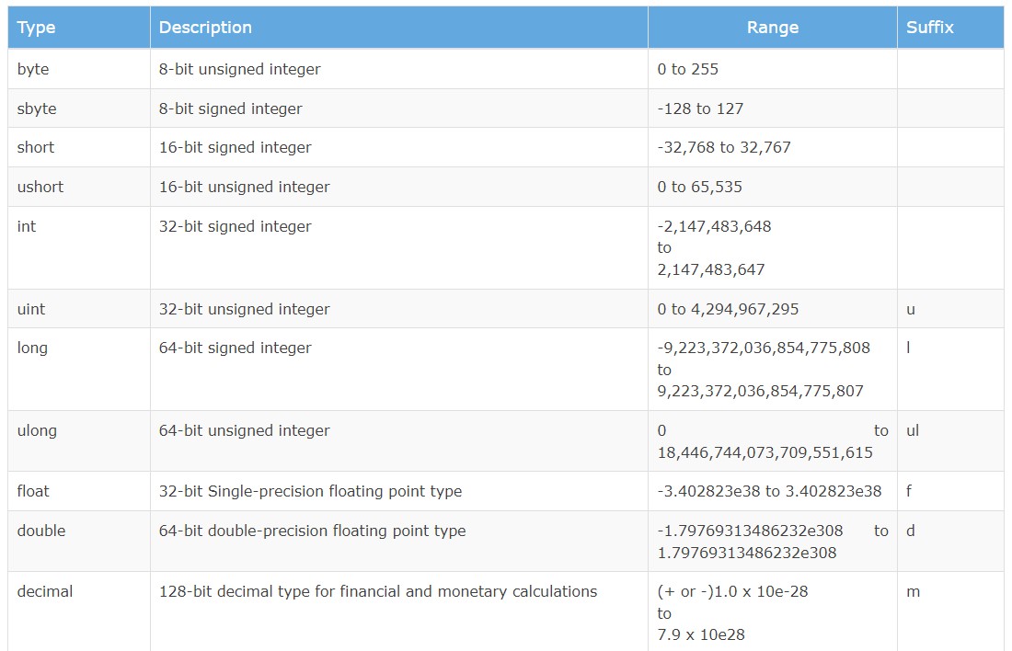



C# Integers:
Integers are whole numbers for example -1, 0, 1, 2, 3.
@Sinaiunieg
info@su.edu.eg
www.su.edu.eg

Slide 33
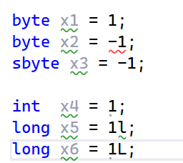
C# Integers:
@Sinaiunieg
info@su.edu.eg
www.su.edu.eg

Slide 34
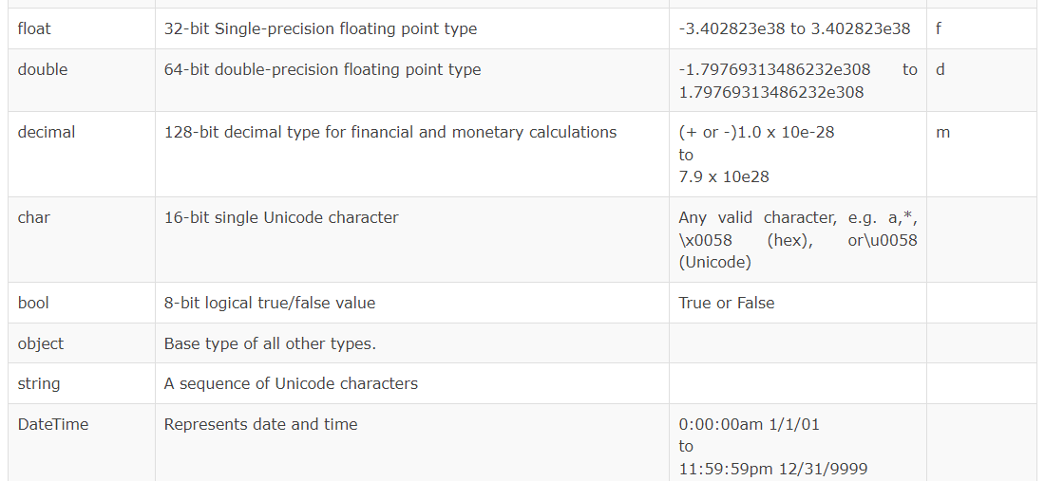
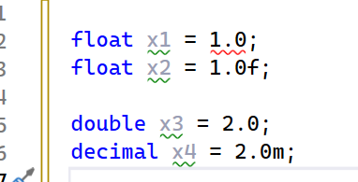



C# float types:
@Sinaiunieg
info@su.edu.eg
www.su.edu.eg

Slide 35
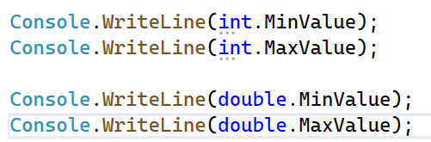
C# Numbers:
Min and Max values:
@Sinaiunieg
info@su.edu.eg
www.su.edu.eg

Slide 36
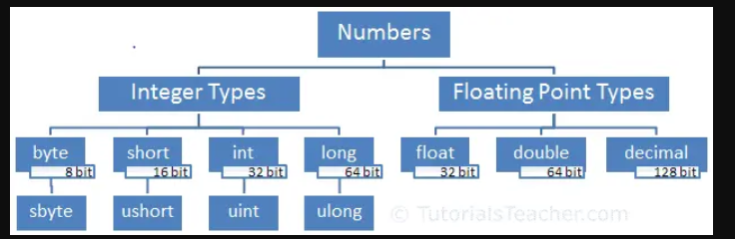
@Sinaiunieg
info@su.edu.eg
www.su.edu.eg

Slide 37
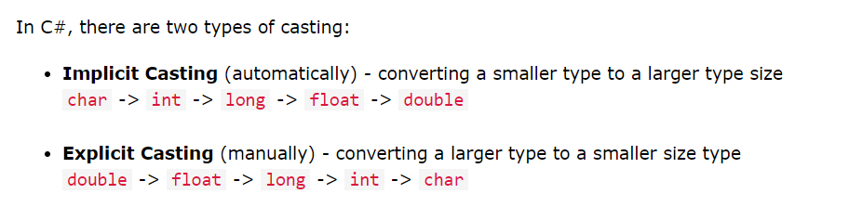
C# Type Casting:
Type casting is when you assign a value of one data type to another type.
@Sinaiunieg
info@su.edu.eg
www.su.edu.eg

Slide 38
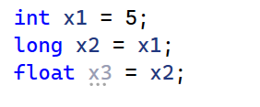
C# Type Casting:
Implicit Casting:
@Sinaiunieg
info@su.edu.eg
www.su.edu.eg

Slide 39
C# Type Casting:
Explicit Casting:
(the target type in parentheses).
Convert Class.
Parse() Method (To convert strings to their respective types)
ToString
@Sinaiunieg
info@su.edu.eg
www.su.edu.eg

Slide 40
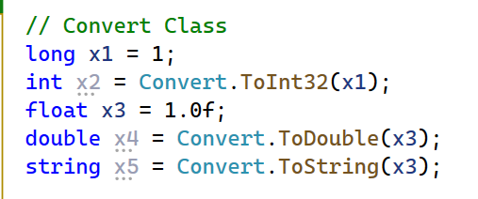
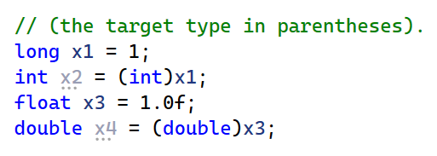
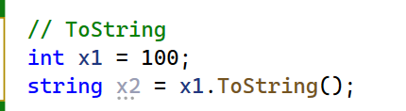
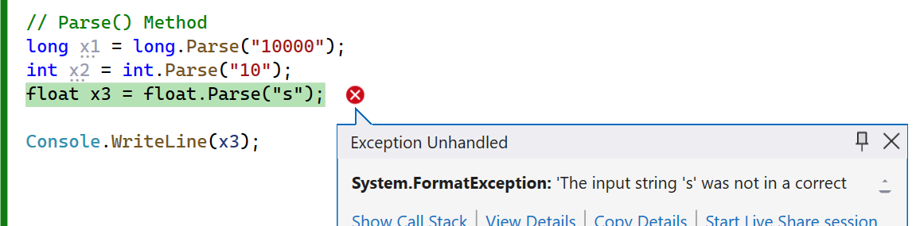
C# Type Casting:
@Sinaiunieg
info@su.edu.eg
www.su.edu.eg

Slide 41
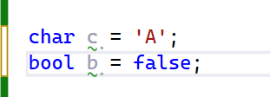
C# - The other types:
@Sinaiunieg
info@su.edu.eg
www.su.edu.eg

Slide 42
C# String:
C# uses the string keyword to represent the string type.
To create a zero-length string:
you use the String.Empty like this:
string message = String.Empty;
It’s equivalent to the following:
string message = "";
@Sinaiunieg
info@su.edu.eg
www.su.edu.eg

Slide 43
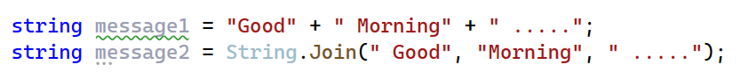
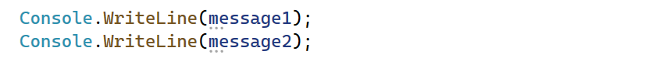
C# String:
To concatenate strings into one:
+ operator
Join() method
@Sinaiunieg
info@su.edu.eg
www.su.edu.eg

Slide 44
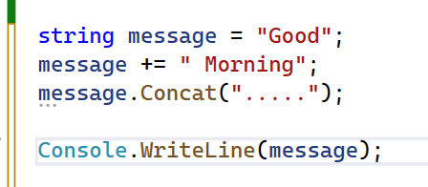
C# String:
To append a string to another:
you can also use the += operator
Concat() method
@Sinaiunieg
info@su.edu.eg
www.su.edu.eg

Slide 45
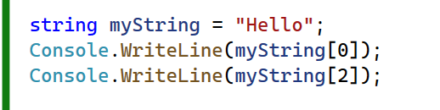
C# String:
Access Strings
@Sinaiunieg
info@su.edu.eg
www.su.edu.eg

Slide 46
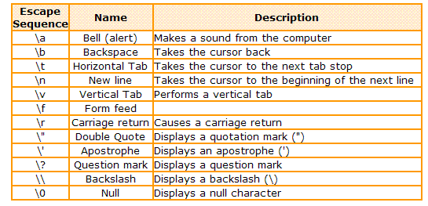
C# Escape sequences:
@Sinaiunieg
info@su.edu.eg
www.su.edu.eg

Slide 47
C# Escape sequences:
If a string contains backslashes, you can escape them using backslashes.
But double backslashes make the string difficult to read. To fix this, you can use the @ symbol.
@Sinaiunieg
info@su.edu.eg
www.su.edu.eg

Slide 48
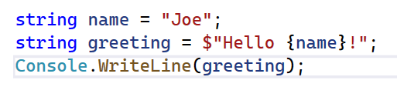
C# Interpolated string:
Suppose you have a variable called name and you want to embed the variable in a literal string.
To do that, you prefix the literal string with the $ character and place the variable inside the curly braces {}:
@Sinaiunieg
info@su.edu.eg
www.su.edu.eg

Slide 49
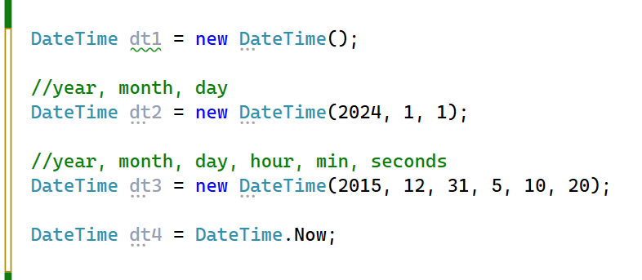
C# DateTime:
@Sinaiunieg
info@su.edu.eg
www.su.edu.eg

Slide 50
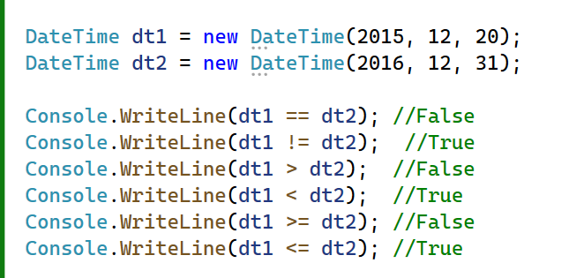
C# DateTime:
@Sinaiunieg
info@su.edu.eg
www.su.edu.eg

Slide 51
C# Enumeration:
An enumeration is used to define a constant set of values. For example, the days of the week.
In C#, the enumeration is defined with the help of the keyword ‘enum’.
@Sinaiunieg
info@su.edu.eg
www.su.edu.eg

Slide 52
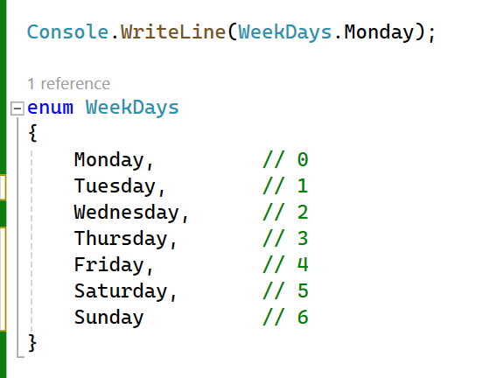
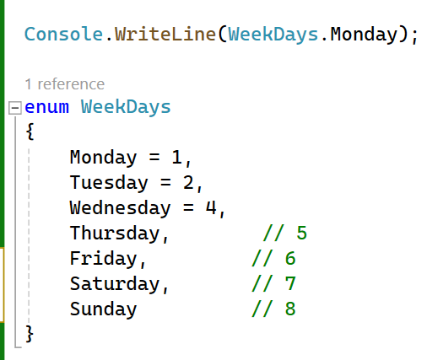
C# Enumeration:
@Sinaiunieg
info@su.edu.eg
www.su.edu.eg
Notes:
enum WeekDays { Monday, Tuesday, Wednesday, Thursday, Friday, Saturday, Sunday }

Slide 53
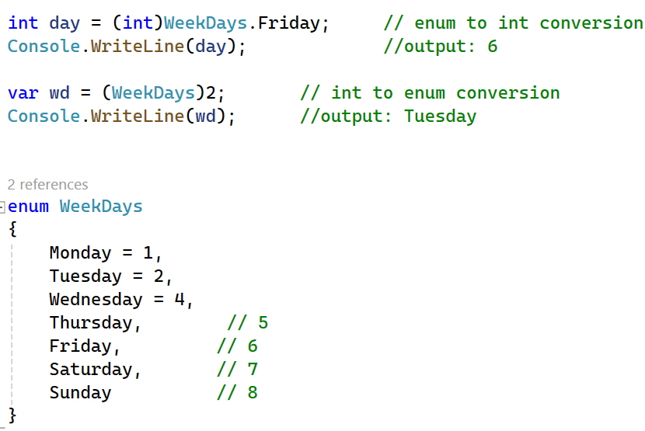
C# Enumeration:
Conversion:
@Sinaiunieg
info@su.edu.eg
www.su.edu.eg

Slide 54
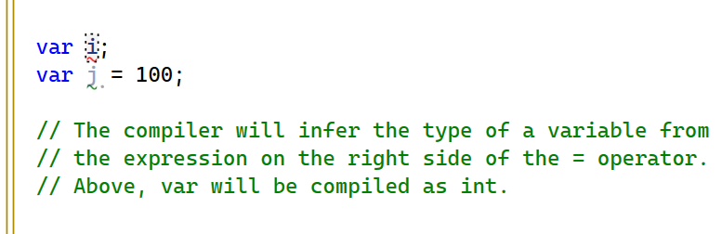
C# var:
@Sinaiunieg
info@su.edu.eg
www.su.edu.eg

Slide 55
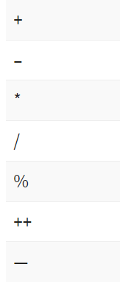
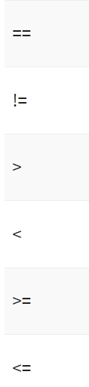
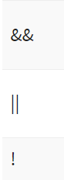
C# Operators:
Arithmetic Operators Relational Operators Logical Operators
@Sinaiunieg
info@su.edu.eg
www.su.edu.eg

Slide 56
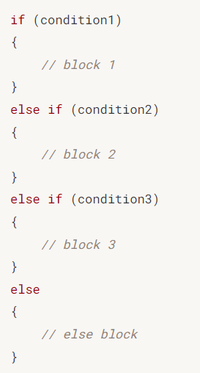
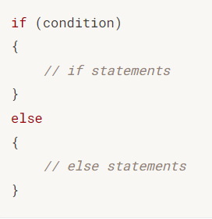

Control flow
C# if:
@Sinaiunieg
info@su.edu.eg
www.su.edu.eg

Slide 57



Control flow
C# if:
@Sinaiunieg
info@su.edu.eg
www.su.edu.eg

Slide 58

Control flow
Nested C# if statement:
@Sinaiunieg
info@su.edu.eg
www.su.edu.eg

Slide 59

Control flow
C# - Ternary Operator ?:
@Sinaiunieg
info@su.edu.eg
www.su.edu.eg

Slide 60


Control flow
C# switch:
@Sinaiunieg
info@su.edu.eg
www.su.edu.eg

Slide 61


Control flow
C# switch:
@Sinaiunieg
info@su.edu.eg
www.su.edu.eg

Slide 62

Control flow
C# switch:
@Sinaiunieg
info@su.edu.eg
www.su.edu.eg

Slide 63


Control flow
C# while:
@Sinaiunieg
info@su.edu.eg
www.su.edu.eg

Slide 64


Control flow
C# do while:
@Sinaiunieg
info@su.edu.eg
www.su.edu.eg

Slide 65


Control flow
C# for loop:
@Sinaiunieg
info@su.edu.eg
www.su.edu.eg

Slide 66


Control flow
C# break & C# continue:
@Sinaiunieg
info@su.edu.eg
www.su.edu.eg

Slide 67

Control flow
C# foreach:
@Sinaiunieg
info@su.edu.eg
www.su.edu.eg

Slide 68


Functions
@Sinaiunieg
info@su.edu.eg
www.su.edu.eg

Slide 69

Functions
Returning a value:
@Sinaiunieg
info@su.edu.eg
www.su.edu.eg

Slide 70

Functions
C# Default Parameters:
@Sinaiunieg
info@su.edu.eg
www.su.edu.eg

Slide 71

Functions
C# - Passing Parameters by Reference
@Sinaiunieg
info@su.edu.eg
www.su.edu.eg

Slide 72



Array
C# Array:
type[] arrayName;
@Sinaiunieg
info@su.edu.eg
www.su.edu.eg

Slide 73


Array
C# Array:
@Sinaiunieg
info@su.edu.eg
www.su.edu.eg

Slide 74
Array
C# Array (Ranges):
The following returns a new array that stores the first N elements in an array.
arrayName[..N]
The following returns a new array that stores all the elements starting from the N element to the end of the array:
arrayName[N..]
@Sinaiunieg
info@su.edu.eg
www.su.edu.eg

Slide 75
Array
C# Array (Ranges):
The following returns a new array that stores the elements from the N to M element:
arrayName[N..M]
@Sinaiunieg
info@su.edu.eg
www.su.edu.eg
Notes:
int[] scores = { 3, 2, 5, 4, 1 };
Console.WriteLine("scores:");
PrintArray(scores);
// get the first two elements
int[] subScores = scores[..2];
Console.WriteLine("scores[2..]:");
PrintArray(subScores);
// get the elements starting from the 3rd element
subScores = scores[2..];
Console.WriteLine("scores[2..]:");
PrintArray(subScores);
// get all the elements starting from the 2nd element
Console.WriteLine("scores[1..3]:");
subScores = scores[1..3];
PrintArray(subScores);
Range r = 1..3;

Slide 76

Array
C# Array (Ranges):
@Sinaiunieg
info@su.edu.eg
www.su.edu.eg
Notes:
int[] scores = { 3, 2, 5, 4, 1 };
Console.WriteLine("scores:");
PrintArray(scores);
// get the first two elements
int[] subScores = scores[..2];
Console.WriteLine("scores[2..]:");
PrintArray(subScores);
// get the elements starting from the 3rd element
subScores = scores[2..];
Console.WriteLine("scores[2..]:");
PrintArray(subScores);
// get all the elements starting from the 2nd element
Console.WriteLine("scores[1..3]:");
subScores = scores[1..3];
PrintArray(subScores);
Range r = 1..3;

Slide 77



Array
C# 2D array:
Accessing array elements
@Sinaiunieg
info@su.edu.eg
www.su.edu.eg

Slide 78

Array
C# Passing an Array to a Function:
@Sinaiunieg
info@su.edu.eg
www.su.edu.eg

Slide 79

Array
C# Passing an Array to a Function:
@Sinaiunieg
info@su.edu.eg
www.su.edu.eg

Slide 80

C# - Nullables:
C# provides a special data types, the nullable types, to which you can assign normal range of values as well as null values.
< data_type> ? <variable_name> = null;
@Sinaiunieg
info@su.edu.eg
www.su.edu.eg

Slide 81

C# - Nullables:
The Null Coalescing Operator (??):
@Sinaiunieg
info@su.edu.eg
www.su.edu.eg

Slide 82

C# - Exception Handling:
@Sinaiunieg
info@su.edu.eg
www.su.edu.eg

Slide 83

C# - Exception Handling:
@Sinaiunieg
info@su.edu.eg
www.su.edu.eg

Slide 84

Get the input number:
@Sinaiunieg
info@su.edu.eg
www.su.edu.eg

Slide 85

THANK YOU
muhammad.saeed@su.edu.eg
Eng. Muhammad Saeed

